Slide 1
Accounting and Financial Reporting Chapters 1 and 2

Slide 2
What is the point of accounting?
To synthesize and present information about a business and its activities in a relevant, reliable, and timely manner so that external parties (investors and creditors) can make decisions about what they might want to do as it relates to that business.
Do I want to buy stock in this company? If so, how many shares?
Do I want to sell the stock that I already own in this company?
Do I want to lend money to this company? If so, how much money? What interest rate will I charge?

Slide 3
Learning Objectives – Chapter 1
You are not required to read Chapter 1, but I have included a few things from that Chapter that I think are instructive.
After studying this chapter, you should be able to:
Recognize the information conveyed in each of the basic financial statements and the way that it is used by different decision makers (investors, creditors, and managers).
Identify the role of generally accepted accounting principles (GAAP) in determining financial statement content and how companies ensure the accuracy of their financial statements.

Slide 4
Learning Objectives – Chapter 2
After studying this chapter, you should be able to:
Define the objective of financial reporting, the elements of the balance sheet, and the related key accounting assumptions and principles.
Identify what constitutes a business transaction and recognize common balance sheet account titles used in business.
Apply transaction analysis to simple business transactions in terms of the accounting model: Assets = Liabilities + Stockholders' Equity.
Determine the impact of business transactions on the balance sheet using two basic tools: Journal entries and T-accounts.
Prepare a trial balance and simple classified balance sheet and analyze the company using the current ratio.
Identify investing and financing transactions and demonstrate how they impact cash flows.

Slide 5
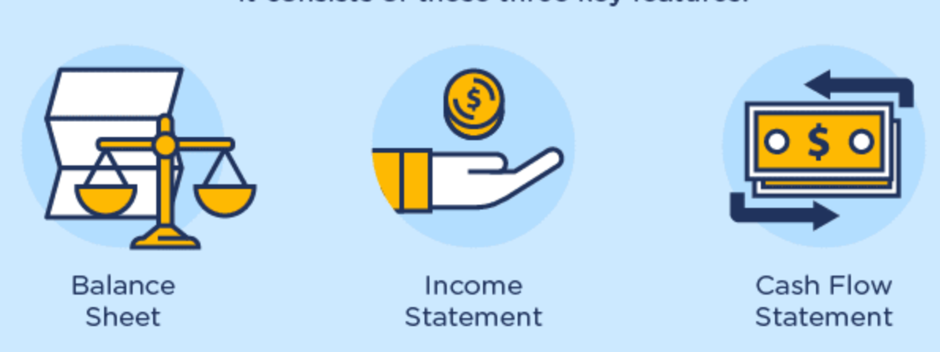
Financial Statements
A set of organizational tools that tell the story of what happened over the last period of time and where the entity stands today.
Graphics Source: www.visualcapitalist.com

Slide 6
A statement that tells us what we own, what we owe, and the difference between those two things as of a single point in time.
A statement that tells us how much revenue we generated and how much expense we incurred over a period of time.
Assets = Liabilities + Shareholders’ Equity
(Basic Accounting Equation)
Revenues – Expenses = Net Income
Graphics Source: www.visualcapitalist.com

Slide 7
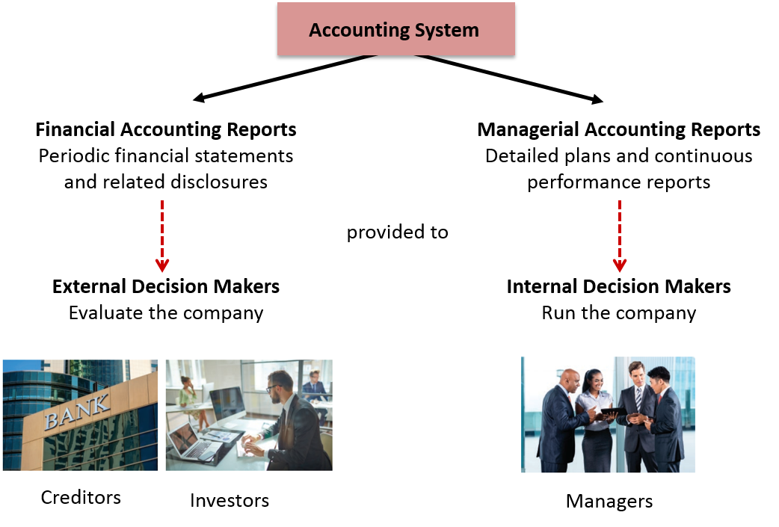
The Accounting System and Decision Makers

Slide 8

Elements of an Income Statement
Expenses Resources used to earn period’s revenues.
Examples:
Cost of Goods Sold Wages Expense Rent Expense Depreciation Expense Insurance Expense Repair Expense Income Tax Expense
Revenues Cash and/or promises received from delivery of goods and services.
Examples:
Sales Revenue Interest Revenue Rent Revenue

Slide 9
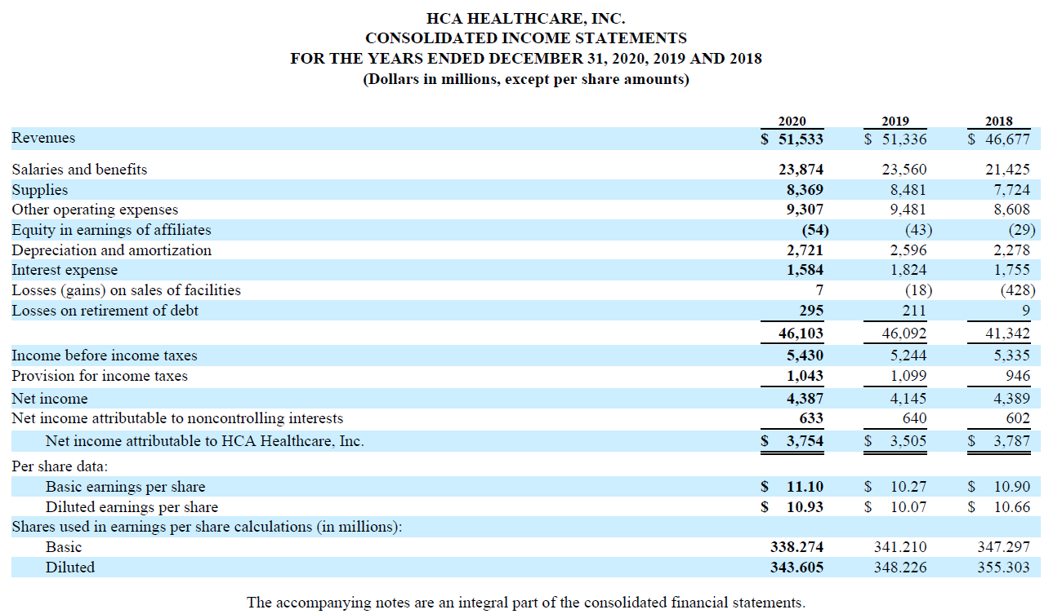
Sample Income Statement

Slide 10
Elements of a Balance Sheet
Assets Cash Short-Term Investments Accounts Receivable Notes Receivable Inventory (to be sold) Supplies Prepaid Expenses Long-Term Investments Equipment Buildings Land Intangibles
Liabilities Accounts Payable Accrued Expenses Notes Payable Taxes Payable Unearned Revenue Bonds Payable
Stockholders’ Equity Contributed Capital Retained Earnings

Slide 11
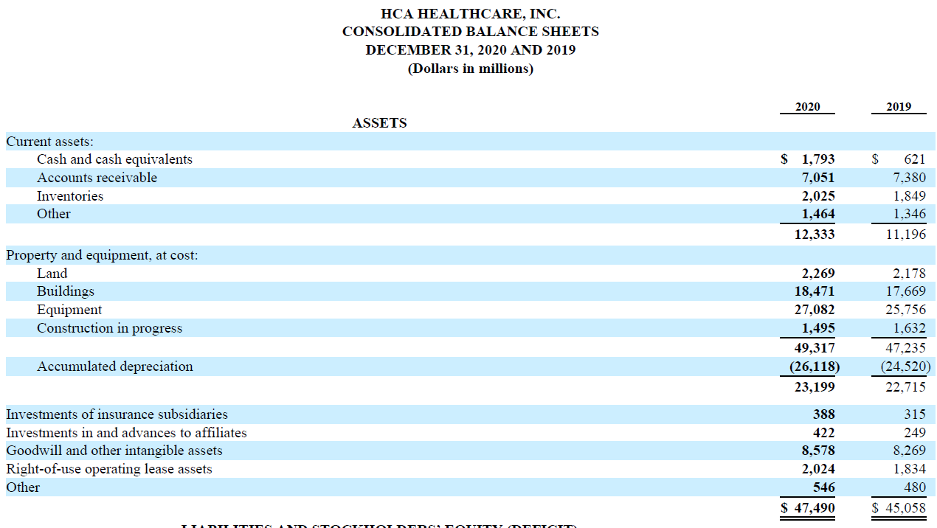
Sample Balance Sheet Assets

Slide 12
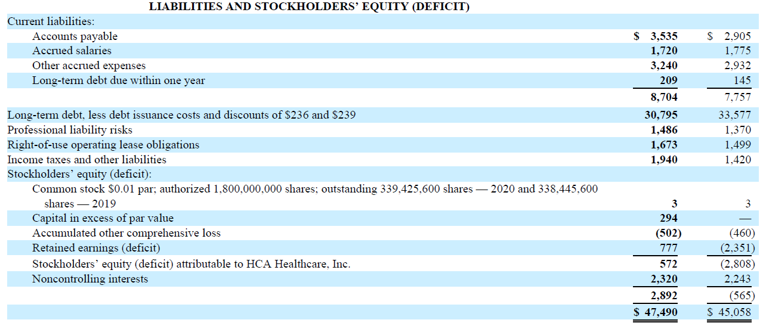
Sample Balance Sheet Liabilities + Equity

Slide 13
Elements of Statement of Equity
Contributed Capital Common Stock
Additional Paid in Capital from Common Stock
Preferred Stock
Additional Paid in Capital from Preferred Stock
Retained Earnings Past earnings not distributed to stockholders.
Beginning Retained Earnings
+ Net Income
− Dividends declared
Ending Retained Earnings

Slide 14
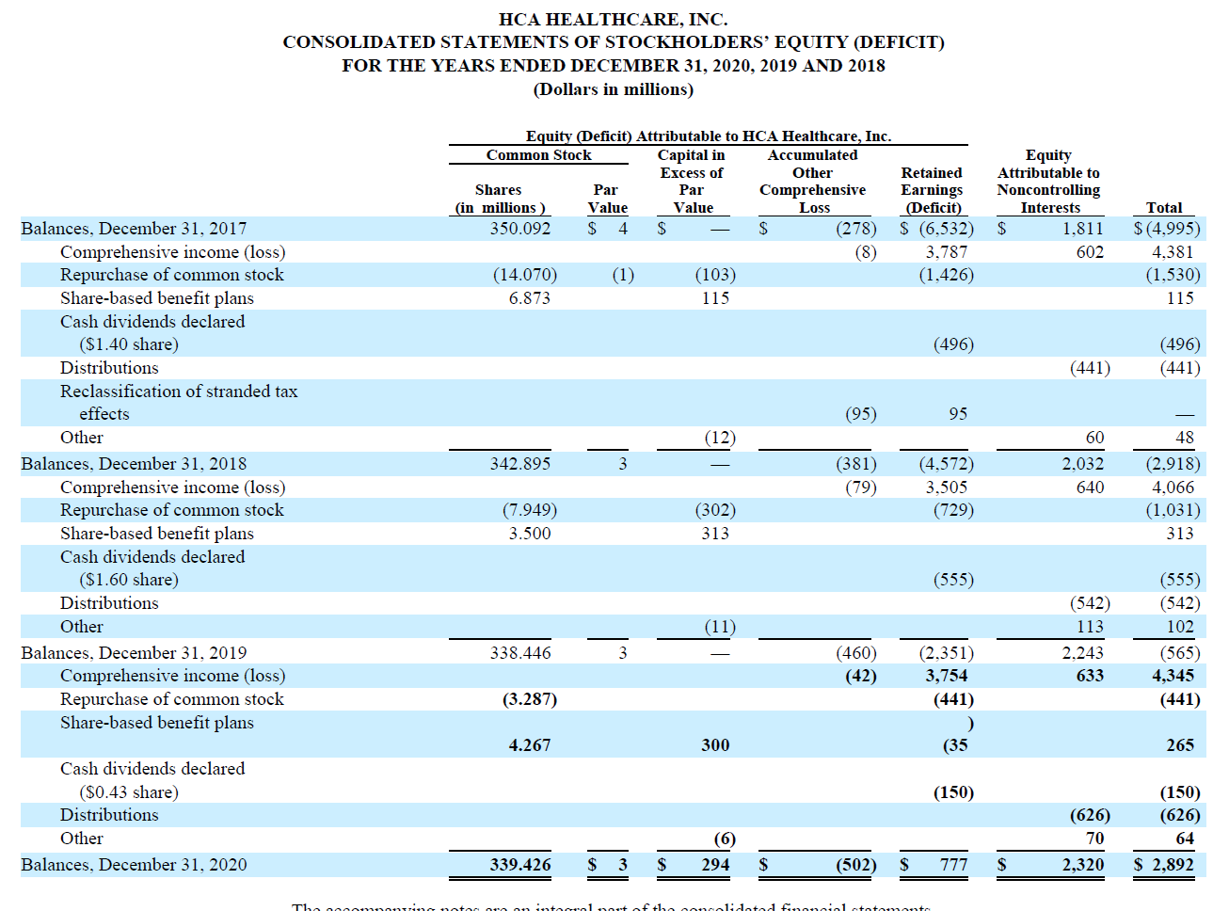
Sample Statement of Equity

Slide 15
Elements of Statement of Cash Flows
Cash Flows from Operating Activities: Cash collected from customers less cash paid for operating expenses such as cash paid to suppliers and employees.
Cash Flows from Investing Activities: Cash flows related to acquisition or sale of the company’s plant and equipment and investments.
Cash Flows from Financing Activities: Cash flows from the receipt or payment of money to investors and creditors (except suppliers)

Slide 16
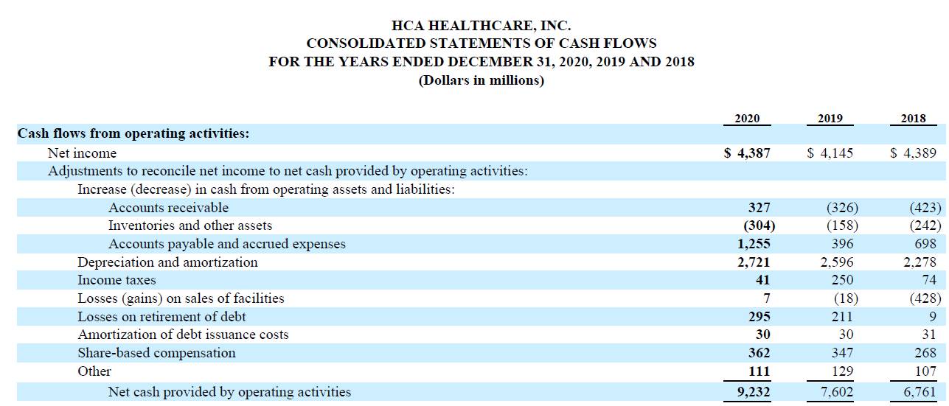
Sample Statement Cash Flows Operating Section

Slide 17
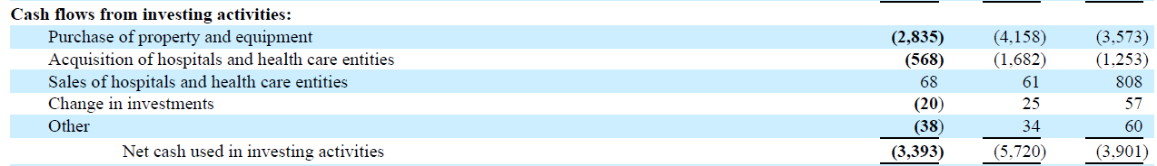
Sample Statement Cash Flows Investing Section

Slide 18
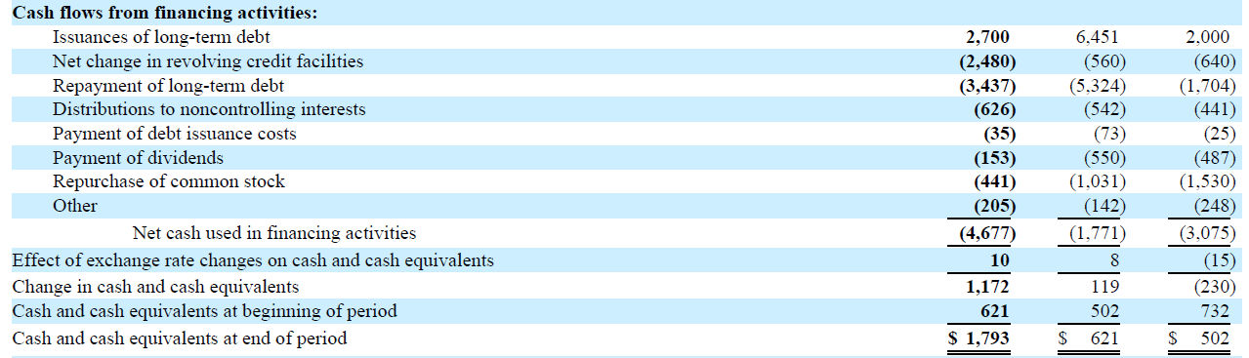
Sample Statement Cash Flows Financing Section

Slide 19
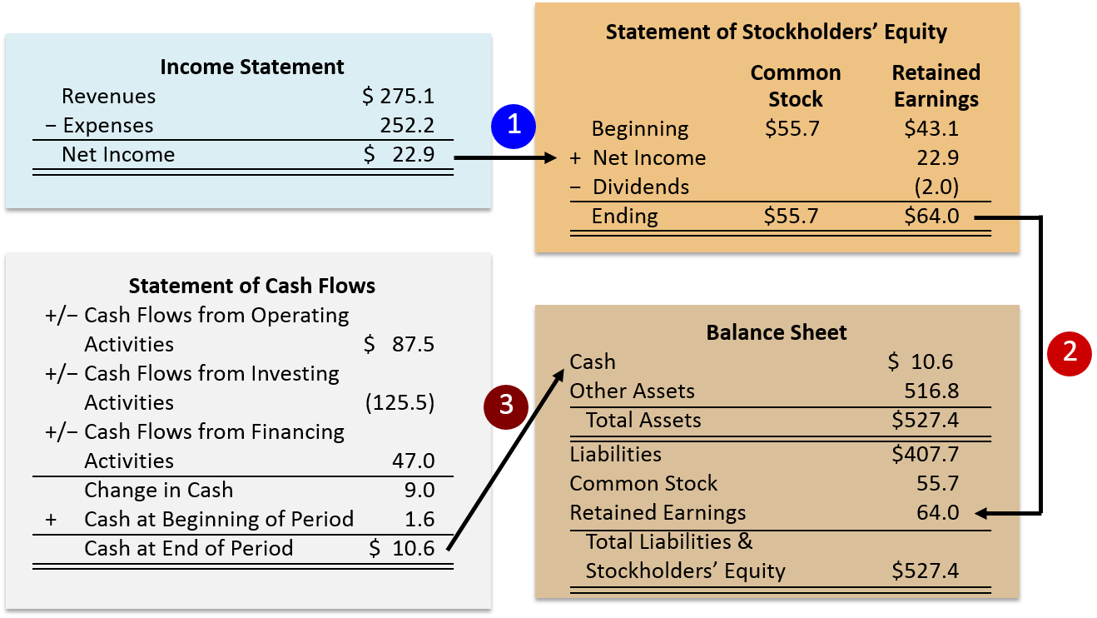
Relationship Among Statements Articulation

Slide 20
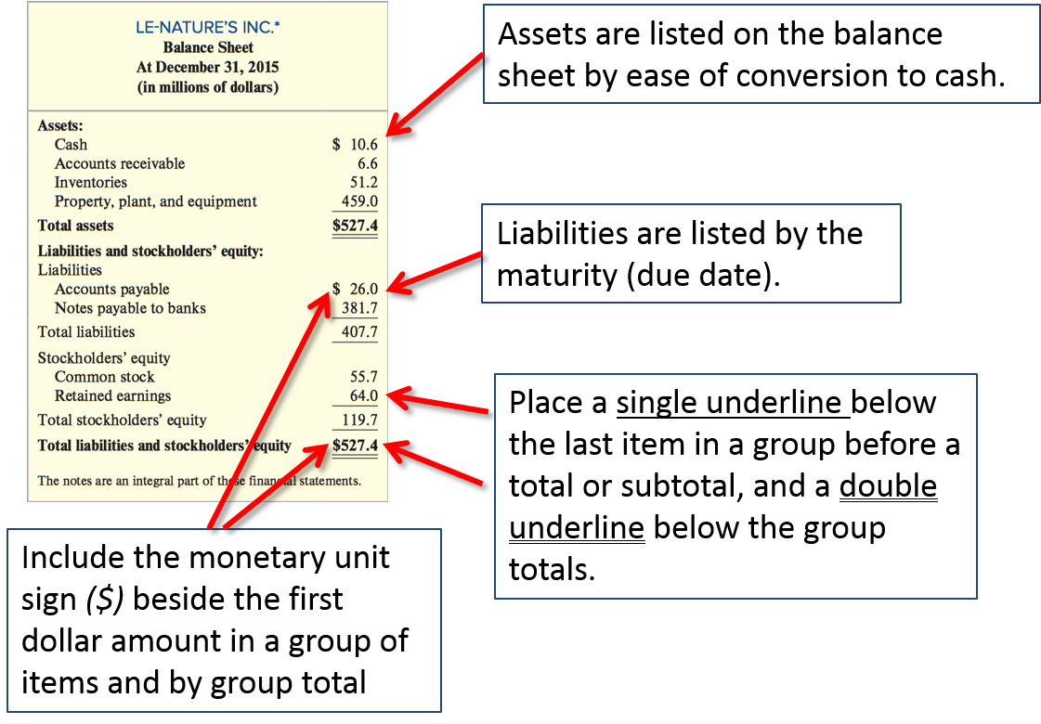
Formatting
This is called liquidity.

Slide 21
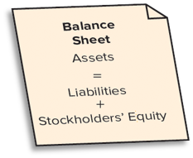
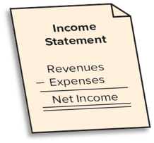

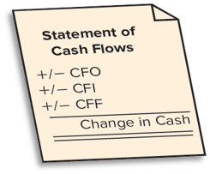
Summary
Financial Statement | Purpose | Structure | Examples of Content
Balance Sheet (Statement of Financial Position) | Reports the financial position (economic resources and sources of financing) of an accounting entity at a point in time. |  | Cash, accounts receivable, plant and equipment, long-term debt, common stock
Income Statement (Statement of Income, Statement of Earnings, Statement of Operations) | Reports the accountant’s primary measure of economic performance during the accounting period. |  | Sales revenue, cost of goods sold, selling expense, interest expense
Statement of Stockholders’ Equity | Reports changes in the company’s common stock and retained earnings during the accounting period. |  | Beginning and ending stockholders’ equity balances, stock issuances, net income, dividends
Statement of Cash Flows (Cash Flow Statement) | Reports inflows (receipts) and outflows (payments) of cash during the accounting period in the categories of operating, investing, and financing. |  | Cash collected from customers, cash paid to suppliers, cash paid to purchase equipment, cash borrowed from banks

Slide 22
Rules that Govern Accounting
Generally Accepted Accounting Principles (GAAP)

Slide 23
A statement that tells us what we own, what we owe, and the difference between those two things as of a single point in time.
Assets = Liabilities + Shareholders’ Equity
(Basic Accounting Equation)
Graphics Source: www.visualcapitalist.com

Slide 24
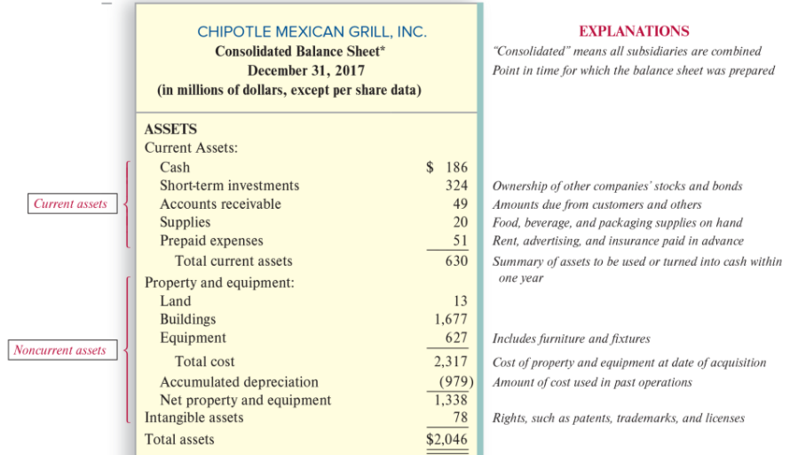
Balance Sheet Assets

Slide 25
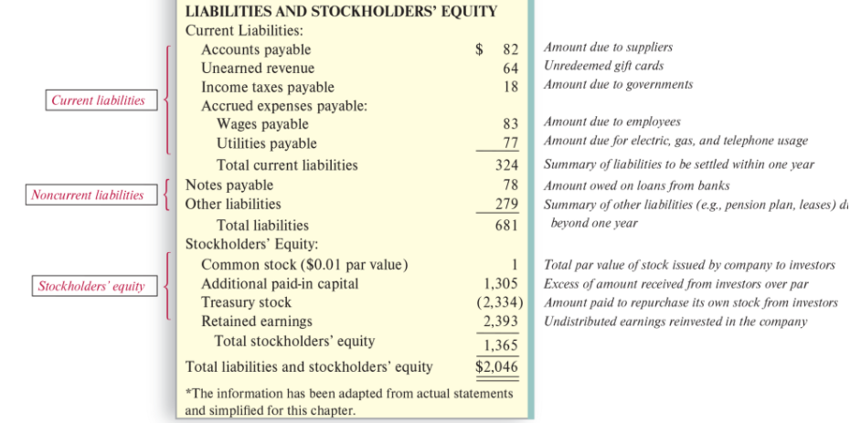
Balance Sheet L + SHE

Slide 26
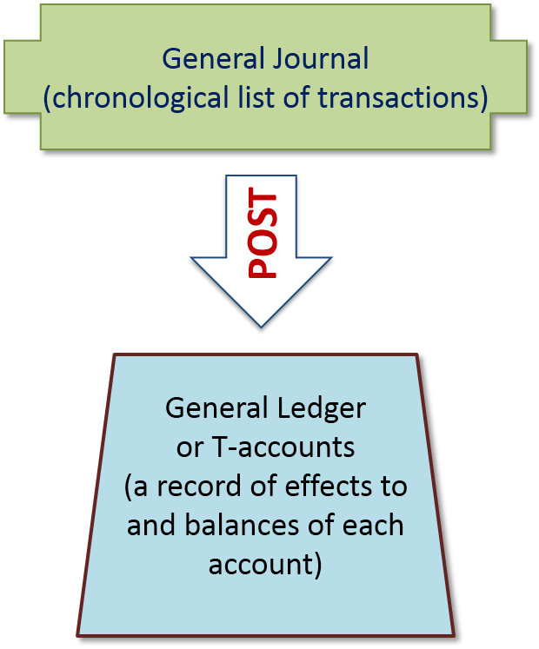
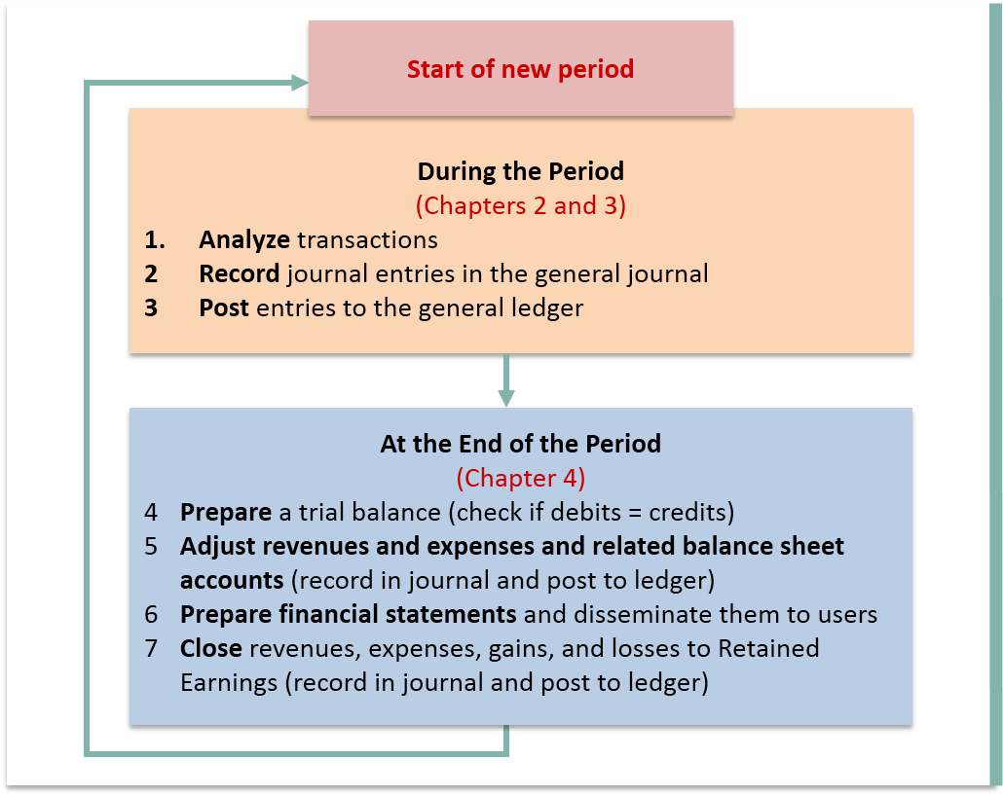
Flow of Work in the Accounting Cycle

Slide 27

Transaction Analysis
Every transaction has at least two effects (dual effects) on the basic accounting equation.
Every transaction affects at least two accounts.
Correctly identifying those accounts and the direction of the effect (whether an increase or a decrease) is critical!
The accounting equation must remain in balance after each transaction.

Slide 28
Debit versus Credit
Debit means “left” and credit means “right.” That’s it. It does not mean “increase” or “decrease” unless you also know what kind of account you are referencing.
Debit (Dr.)
Credit (Cr.)
Journal Entry Format
An increase in an asset,
A decrease in a liability,
A decrease in a shareholders’ equity item
1) A decrease in an asset,
2) An increase in a liability,
3) An increase in a shareholders’ equity item
Account Debited……………Amount Debited
Account Credited………..Amount Credited

Slide 29
An example
Let’s say that we purchased $22,000 of inventory on account…
Journal Entry Format
Inventory 22,000
Accounts Payable 22,000

Slide 30
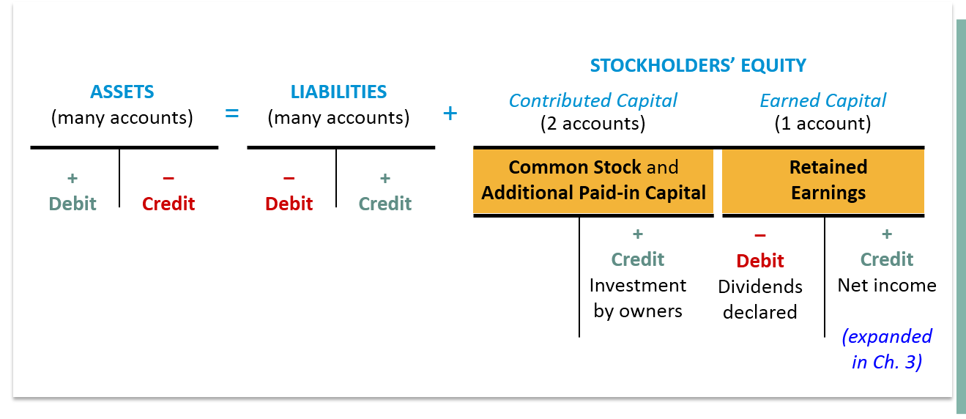
Another way to look at debits versus credits

Slide 31
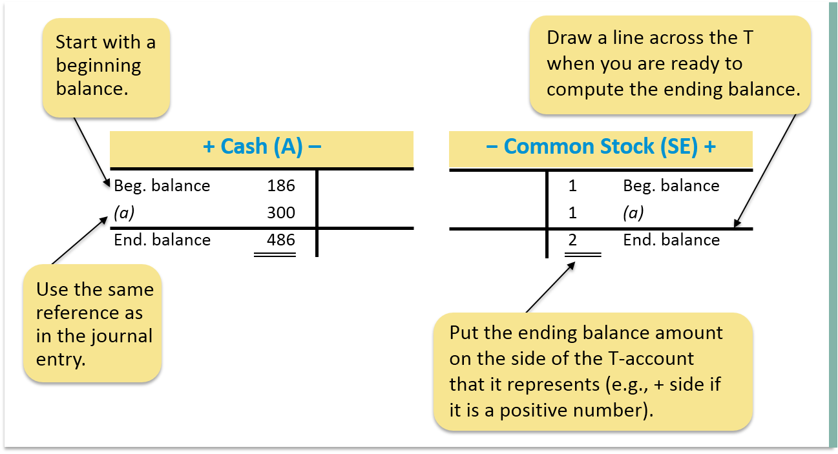
How does a T-account work?
The side on which the account increases is called the normal balance. The beginning balance in an account is always on the side where the account increases.

Slide 32
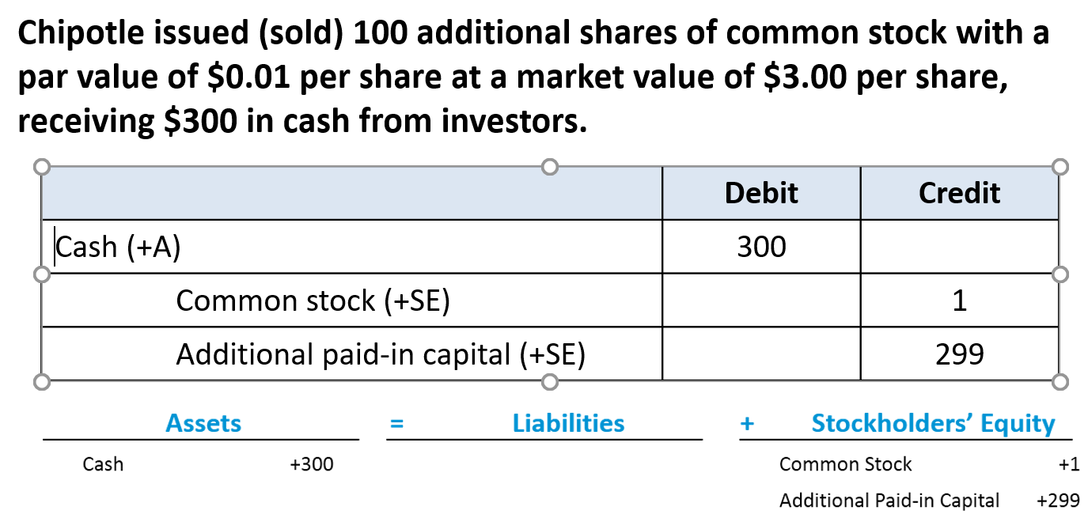
Another example

Slide 33
Get ready…
…the next slide is very important. Print it out. Frame it. Hang it on your refrigerator!
I’m kidding – don’t frame it – but it is important!

Slide 34
Steps in Analyzing Transactions Don’t make this harder than it is!
What accounts (and account types) are involved in the transaction?
Cash, Common Stock, Sales Revenue, etc.
Remember: At least two accounts will be involved
Does the account increase or decrease?
How do I make this kind of account move in that direction?
Assets increase with a debit and decrease with a credit.
Liabilities and Equity accounts increase with a credit and decrease with a debit.
Revenue is recorded with a credit.
Expense is recorded with a debit.

